Slide 1

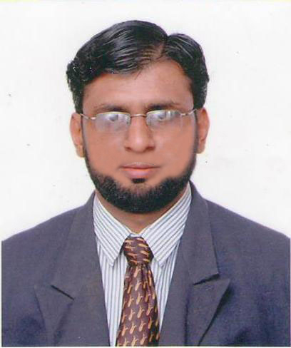
MOHAMMAD CHAUS WIPRO LTD., Pune, India.
Role: DevOps Manager Contact No : +91-9824886204
Total Exp: 17+ Years Email: mohd.chaus@gmail.com
Background
Technical Skills
Certified & Experienced DevOps Manager with 17+ years in CI/CD pipeline automation, Kubernetes and cloud computing (Azure/AWS). Proven expertise in optimizing infrastructure, reducing deployment time, and leading cross-functional DevOps teams to ensure seamless software delivery. Passionate about cloud automation, security, and scaling enterprise applications.
Azure DevOps, CI/CD Automation, AWS ECS Fargate, AKS Orchestration, AWS (EC2, S2, Lambda, EKS), GitLab, Jenkins, Ansible, Docker, Terraform, ASP.NET, C#, MVC, SQL SERVER
Experience Summary
17+ years of total IT Experience
PROFILE KEY HIGHLIGHTS:- DevOps Manager @ WIPRO | PROJECT PLAN | EFFORT & COST ESTIMATION | DESIGN ARCHITECTURE | IMPLEMENTATION | DELIVERY MANAGEMENT
DEVOPS ENGINEERING EXPERIENCE
Currently working independently with US Bank customer in migration project from on premise to Azure Cloud
Build and enhance CI/CD pipelines using Jenkins, Azure DevOps, GitLab CI
Developed & Deployed Java and Spring Boot Maven Microservices in Azure Kubernetes cluster using Helm Charts deployment
Deployed microservices in ECS Fargate cluster
Deployed applications in AWS (EC2, S3, Lambda, CloudFormation, EKS)
Created and successfully deployed Ansible Roles for Automation
Integrated SonarQube, SynopSys Scan, Image Build Kaniko using GitLab CI/CD
Created IaC pipeline and deployed AZURE & AWS infrastructures such as load balancer, VM, Azure file share, PostGres SQL using Terraform and YAML
Hands on experience in using Azure DevOps implementation (Kubernetes cluster, pods, services, ingress and API Management) and Azure Infrastructure Operations
AZURE ARCHITECT EXPERIENCE
Designed and successfully implemented Azure Architect Solutions to developed in VM based solutions, AKS Orchestration and AutoSys Solutions
Provide technical leadership to development teams, guiding them in choosing the right Azure services and components
Experience in designing architecture and high level & low level design document
Regularly optimized cloud resource utilization to ensure cost effectiveness solutions
Education Details
Pursuing DOCTORATE in Business Administration, California, USA. (www.ggu.edu)
Subject: Business Analytics & AI
BACHELOR OF ENGINEERING, Bangalore, INDIA. (www.vtu.ac.in)
Branch: Computer Science & Engineering
Worked with Clients
US Bank
Forward Air
Hewlett Packard
Microsoft
Novartis
Outset Medical
National General Insurance System
Japanese Tobacco International
Federation of Indian Export Organization
Certifications
Experienced as Liaising Officer with Prime Minister of Republic of TCHAD (Africa) at AfDB (www.afdb.org)
PMP Certified professional
Cisco Certified Network Associate
Microsoft Azure Certification

Slide 2
MOHAMMAD CHAUS WIPRO LTD., Pune, India.
Role: DevOps Manager Contact No : +91-9824886204
Total Exp: 17+ Years Email: mohd.chaus@gmail.com
Experience Summary
Personal Details
PROJECT MANAGEMENT EXPERIENCE
Hands on Experience in SOW Management
Developed Comprehensive Project Plan
Monitored project progress through regular status Meetings, Progress Reports, And Performance Metrics
Business Requirement Gathering and Scoping (JIRA/Azure Board/Confluence)
Ensuring the regular delivery of projects with Agile/Scrum methodologies
Experience in performing analysis, consulting, and providing recommendations to clients on business use cases.
.NET EXPERIENCE
Hands on Experience in Microsoft Skills such as .NET, C#, SQL SERVER, MVC
Experience in design patterns such as Singleton, Abstract Factory and SOLID principles
Gender: Male
Languages Known : English, Hindi, Gujarati, Urdu
Passport Number : Z2732709 (Exp.: 2033)
Reference : Mr. P. C. Yadav (M. Sc., Physics)
Deputy Director
Email: yadavpc@icmr.org.in
Contact Number: +91-79-22686279
NIOH - Indian Council of Medical Research, Ahmedabad, India.
(www.icmr.nic.in)
Employment Details
Presently working with WIPRO LTD. from Mar’21 to till date (www.wipro.com)
Role: DevOps Manager
Worked with L&T INFOTECH LTD. from Jun’17 to Sep’20 (www.ltimindtree.com)
Role: Senior DevOps Engineer
Worked with (n)CODE SOLUTIONS from Mar’13 to till Jun’17 (www.ncodesolutions.com)
Role: Senior DevOps Engineer
Worked with EBIZ TECHNOLABS from Apr’12 to Mar’13 (www.ebiztechnolabs.com)
Role: DevOps Engineer
Worked with HERALD SOLUTIONS from Oct’09 to Mar’12 (www.heraldsolutions.in)
Role: Software Engineer
Worked with U&V TECHNOLOGIES from Sep’02 to Aug’04 (www.uandvtech.com)
Role: Jr. Software Engineer

